Slide 1



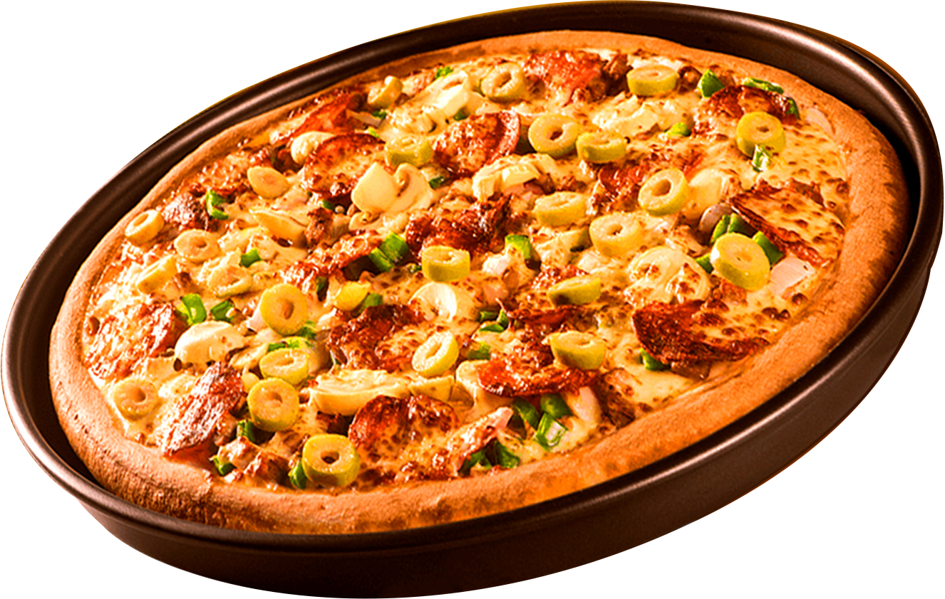
PIZZA SALES ANALYSIS
SQL Project Presentation by Suraj Das
ORDER
NOW
Start Your Slide

Slide 2
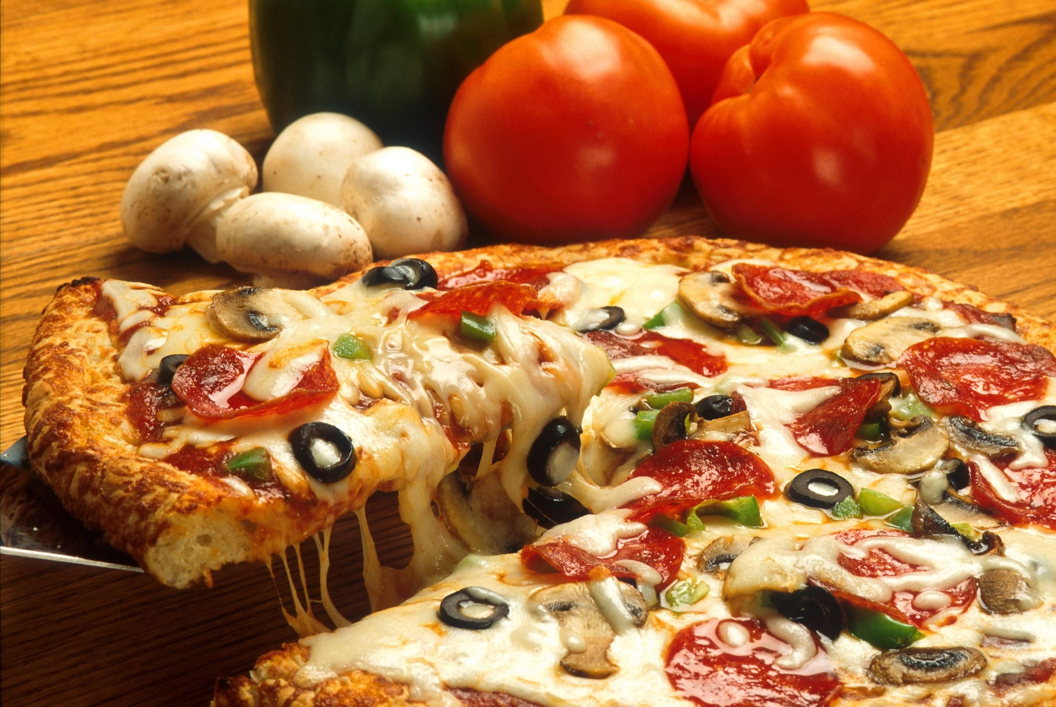
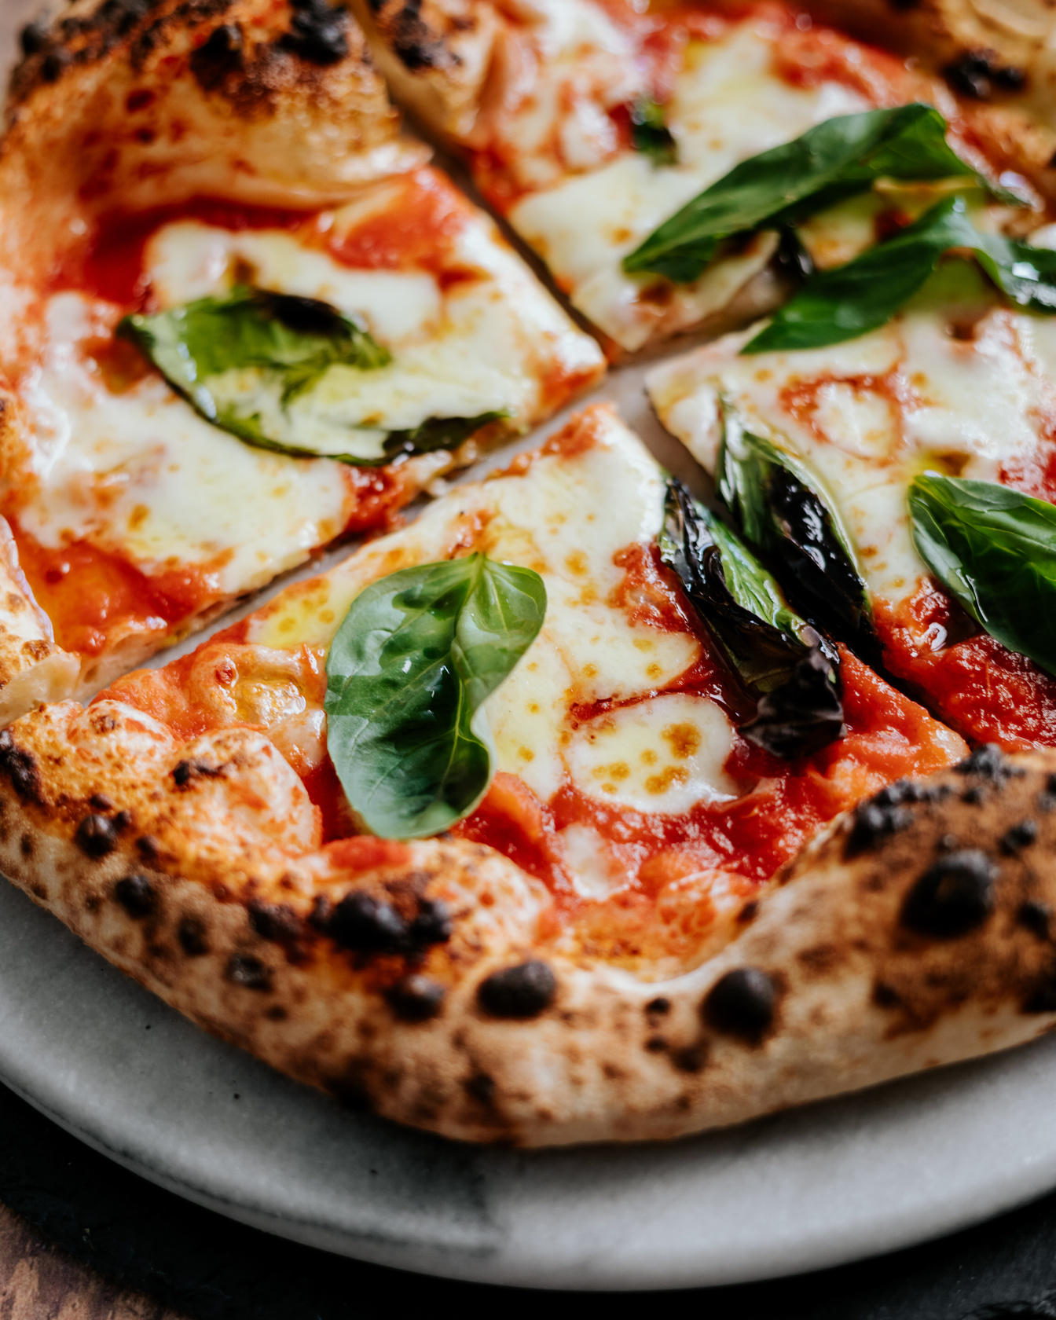
PROJECT OBJECTIVE
Analyze pizza sales data to extract business insights.
Answer business questions using SQL queries.
Focus on sales trends, pizza popularity, revenue, and order patterns.

Slide 3
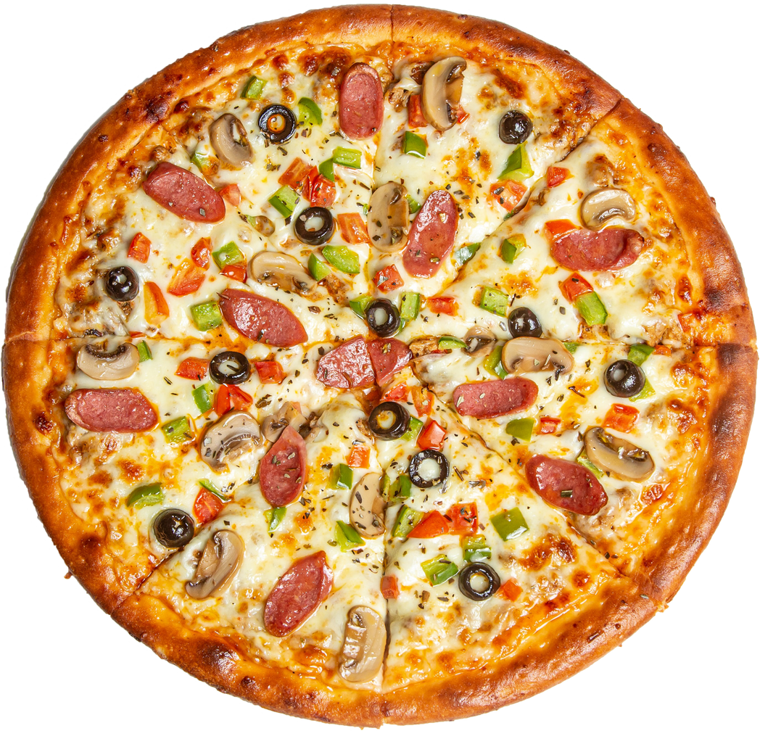
DATASET OVERVIEW
orders.csv – Contains order timestamps.
order_details.csv – Links orders with pizzas and quantity.
pizzas.csv – Pizza size and price.
pizza_types.csv – Type, category, and ingredients of pizzas.
Total Tables Used: 4
ORDER
NOW

Slide 4
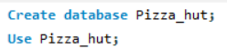
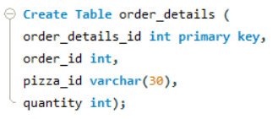
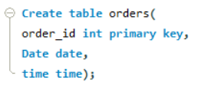
SCHEMA
Table : 1 Order Details
Table : 2 Orders

Slide 5
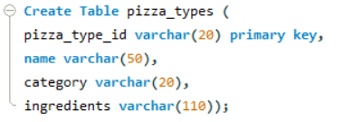
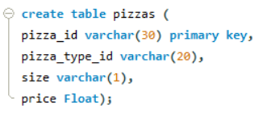

Table : 3 Pizza Types
Table : 4 Pizzas

Slide 6
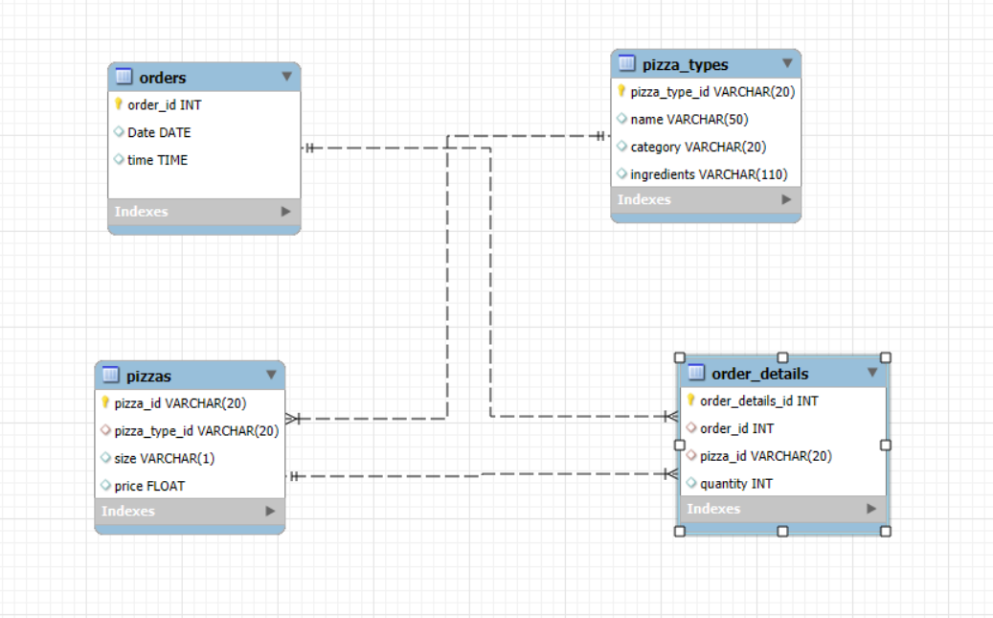
PIZZA SALES DATABASE - ENTITY RELATIONSHIP DIAGRAM (ERD)

Slide 7
BUSINESS PROBLEMS
Basic:
Retrieve the total number of orders placed.
Calculate the total revenue generated from pizza sales.
Identify the highest-priced pizza.
Identify the most common pizza size ordered.
List the top 5 most ordered pizza types along with their quantities.
Intermediate
Join the necessary tables to find the total quantity of each pizza category ordered.
Determine the distribution of orders by hour of the day.
Join relevant tables to find the category-wise distribution of pizzas.
Group the orders by date and calculate the average number of pizzas ordered per day.
Determine the top 3 most ordered pizza types based on revenue.
Advanced:
Calculate the percentage contribution of each pizza type to total revenue.
Analyze the cumulative revenue generated over time.
Determine the top 3 most ordered pizza types based on revenue for each pizza category.

Slide 8
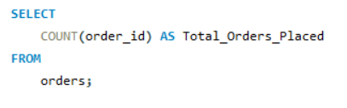
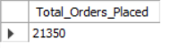
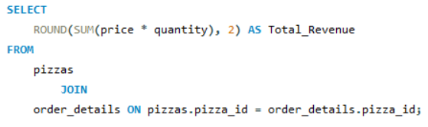
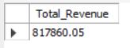
SOLUTION
Q1. RETRIEVE THE TOTAL NUMBER OF ORDERS PLACED.
Result
Q2. CALCULATE THE TOTAL REVENUE GENERATED FROM PIZZA SALES.
Result

Slide 9
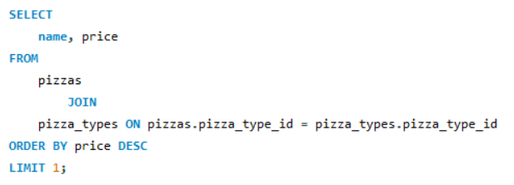
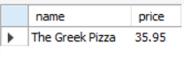
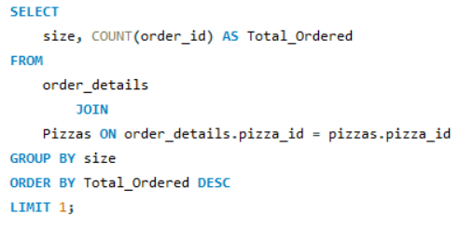
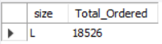
Q3. IDENTIFY THE HIGHEST-PRICED PIZZA.
Result
Q4.IDENTIFY THE MOST COMMON PIZZA SIZE ORDERED.
Result

Slide 10
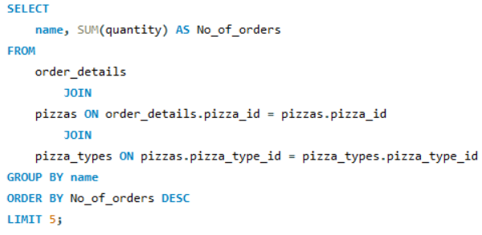
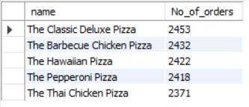
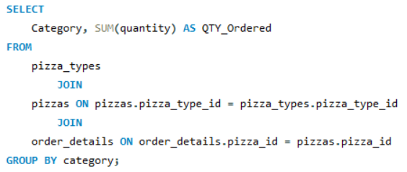
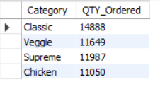
Q5. LIST THE TOP 5 MOST ORDERED PIZZA TYPES ALONG WITH THEIR QUANTITIES.
Result
------ INTERMEDIATE ----
Q6. LIST THE TOP 5 MOST ORDERED PIZZA TYPES ALONG WITH THEIR QUANTITIES.
Result

Slide 11
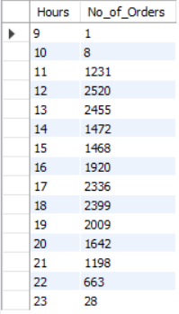
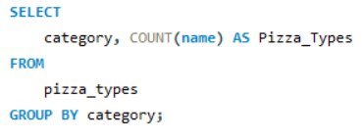
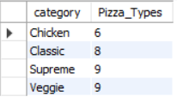
Q7. DETERMINE THE DISTRIBUTION OF ORDERS BY HOUR OF THE DAY.
Result
Q8. JOIN RELEVANT TABLES TO FIND THE CATEGORY-WISE DISTRIBUTION OF PIZZAS.
Result

Slide 12
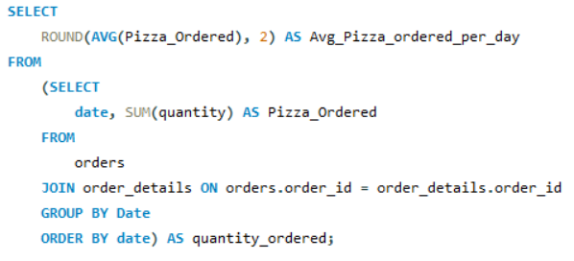
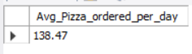
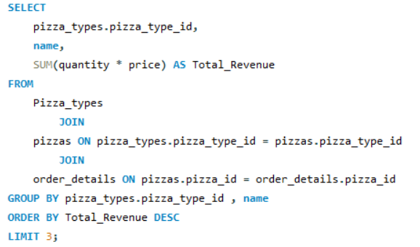
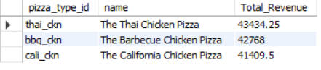
Q9. GROUP THE ORDERS BY DATE AND CALCULATE THE AVERAGE NUMBER OF PIZZAS ORDERED PER DAY.
Result
Q10. DETERMINE THE TOP 3 MOST ORDERED PIZZA TYPES BASED ON REVENUE.
Result

Slide 13
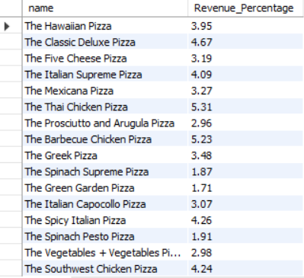
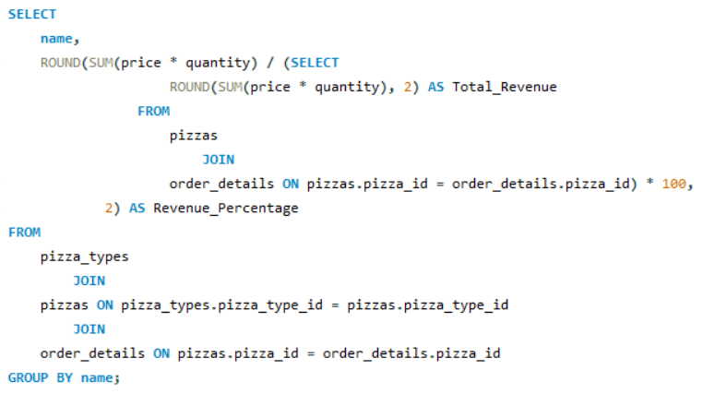
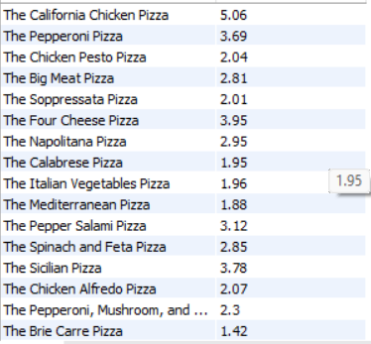
----- ADVANCED -----
Q11. CALCULATE THE PERCENTAGE CONTRIBUTION OF EACH PIZZA TYPE TO TOTAL REVENUE.
Result

Slide 14
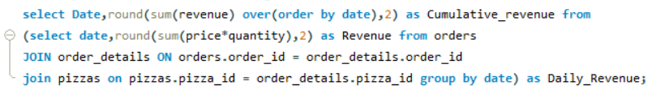
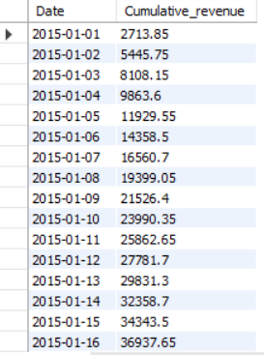
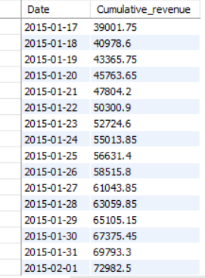
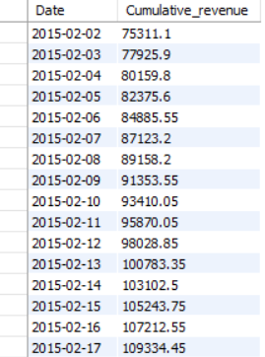
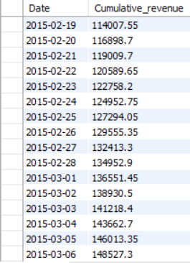
Q12. ANALYZE THE CUMULATIVE REVENUE GENERATED OVER TIME.
RESULT
SO ON.....

Slide 15
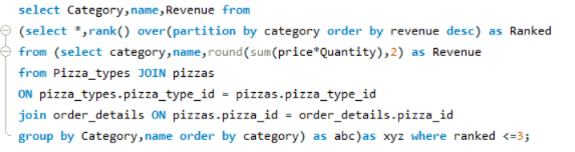
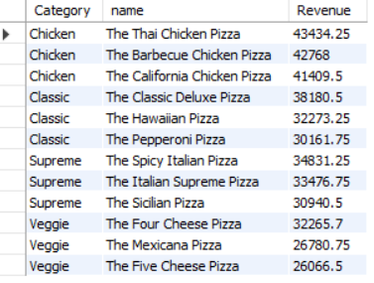
Q13. DETERMINE THE TOP 3 MOST ORDERED PIZZA TYPES BASED ON REVENUE FOR EACH PIZZA CATEGORY.
Result

Slide 16

SUMMARY & KEY TAKEAWAYS
🔍 Explored a real-world sales dataset using structured SQL queries across varying complexity levels.
📈 Identified top-performing pizzas by order volume and revenue, as well as underperforming ones.
🕒 Discovered peak ordering hours and average daily order patterns to help optimize operations.
💰 Analyzed category-wise sales performance and cumulative revenue trends over time.
📊 Utilized advanced SQL techniques like window functions, ranking, and subqueries for deep insights.
🚀 Transformed raw sales data into actionable business intelligence, reinforcing SQL’s value in data-driven decision-making.

Slide 17
THANK YOU
FOR ATTENTION
dsuraj630@gmail.com
linkedin.com/in/suraj-das-a01b02322

